Slide 1
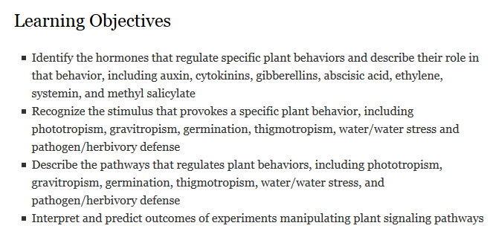
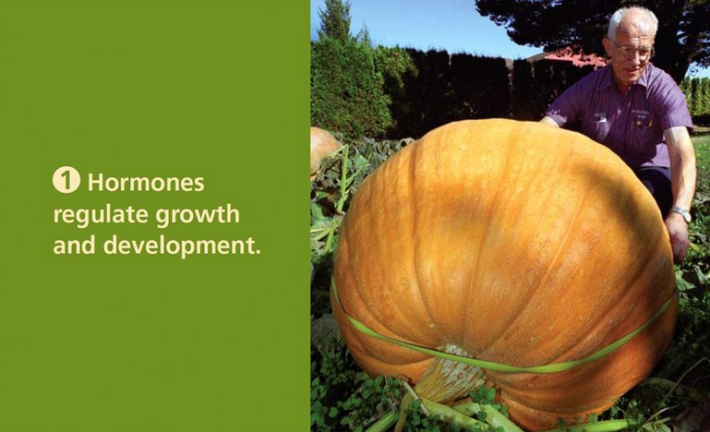
Plant Hormones and Signaling Pathways

Slide 2
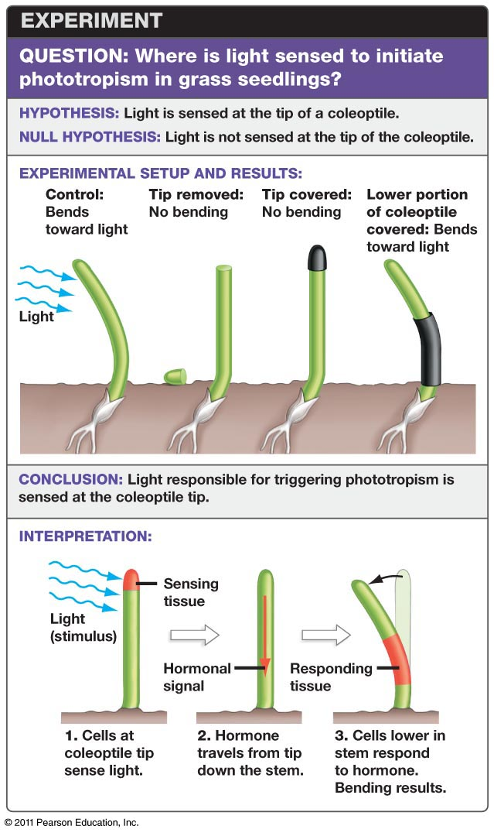
Discovering the phototropic response
Charles Darwin and his son Francis explored the role of light in 1881
Phototropism: directed movement in response to light
Filtered light experiments demonstrated blue light is key for phototropism

Slide 3
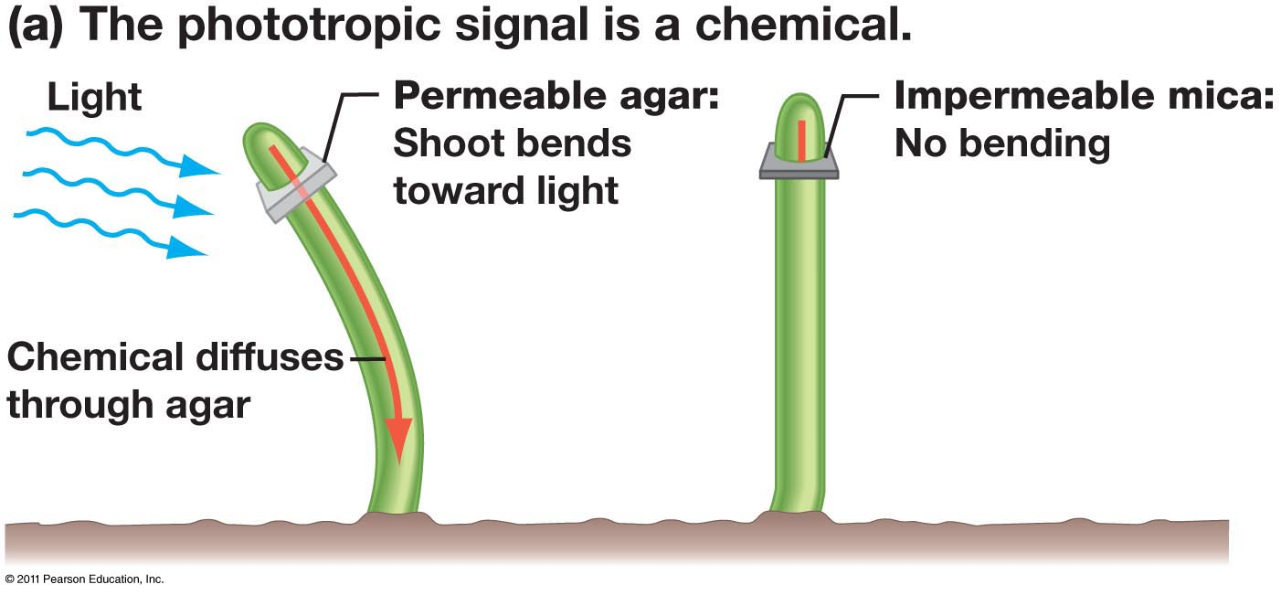
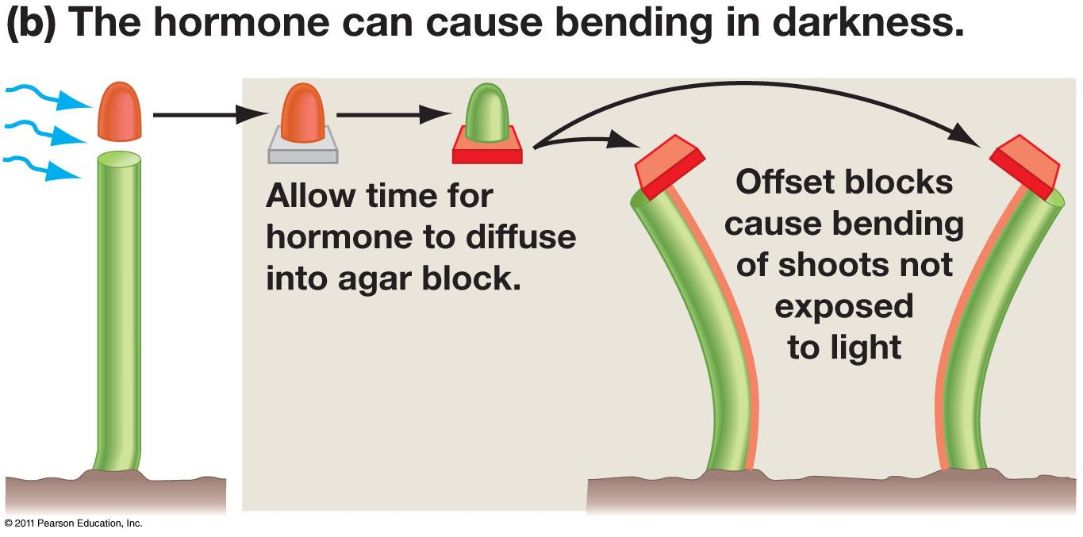
The hormone hypothesis
Sensors are located at tip, but how does bending occur at base?
Peter Boysen-Jensen, 1913, designed an experiment to test for a signaling molecule
Cut tips of oat shoots
Inserted agar or mica plate
Frits Went added to this experiment
Placed agar blocks on oat shoots, slightly offset

Slide 4
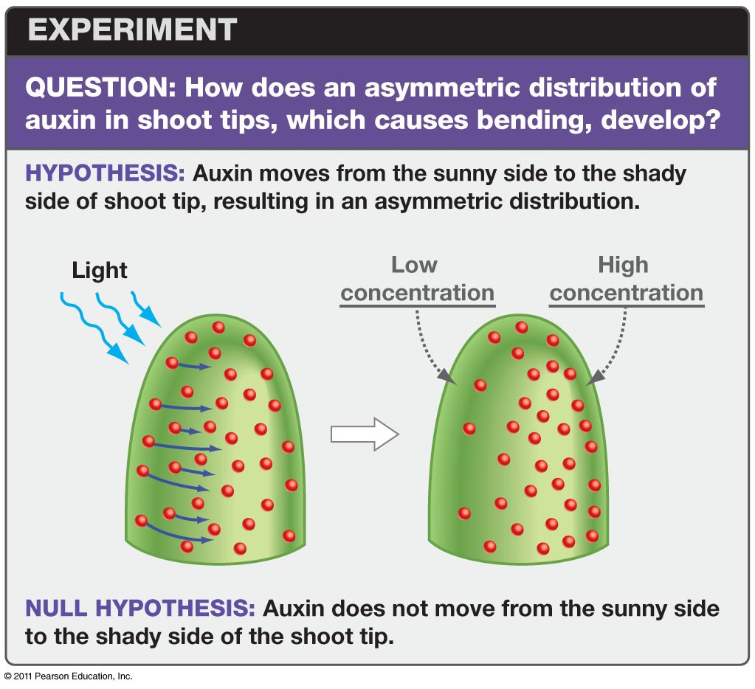
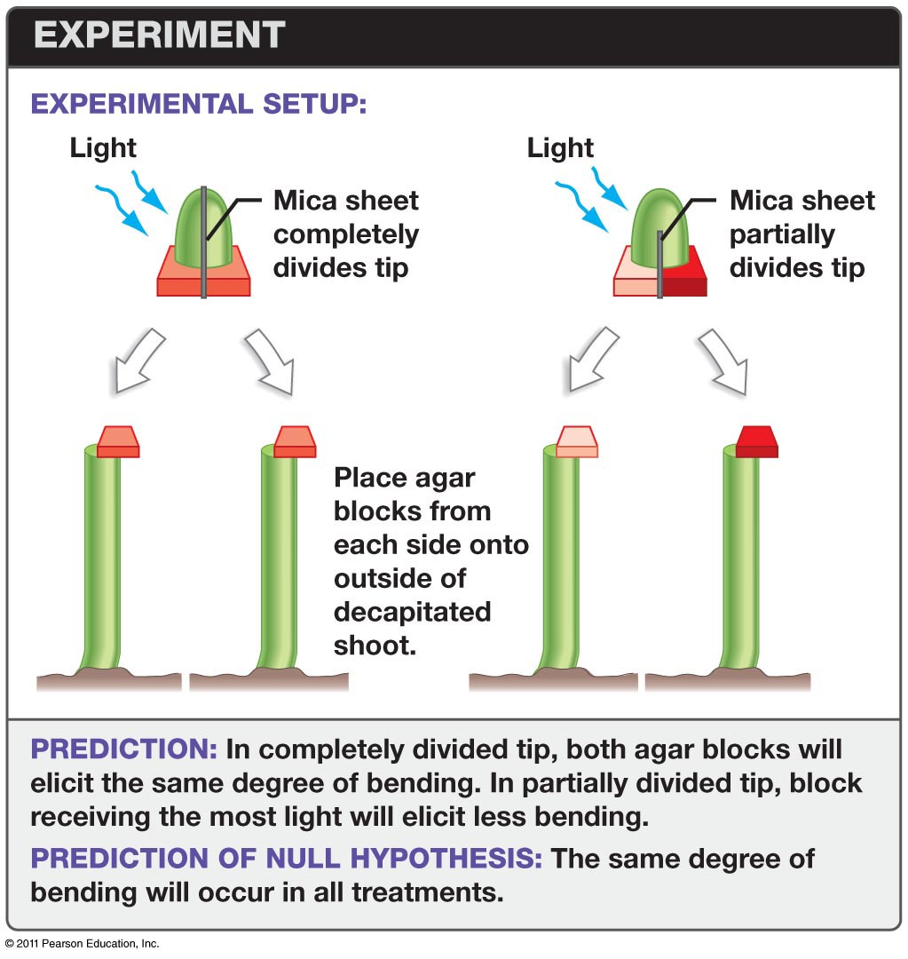
The Cholodny-Went hypothesis: asymmetry

Slide 5
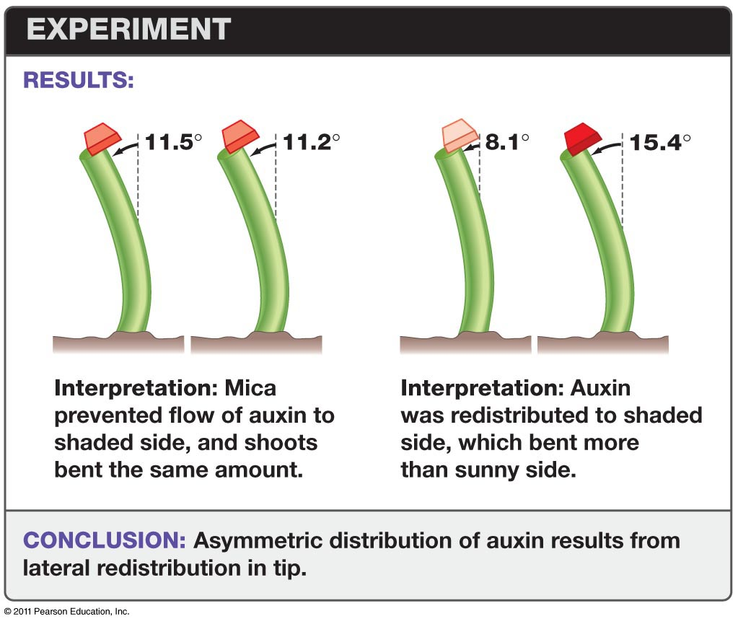
The results of the Cholodny-Went experiment

Slide 6
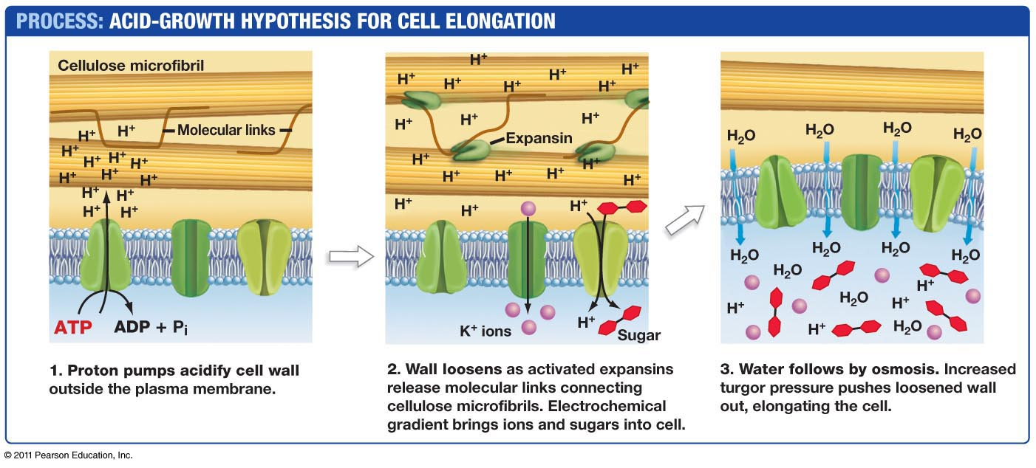
Cell elongation involves intake of water
Auxin causes cells to activate proton pumps, create osmotic gradient

Slide 7
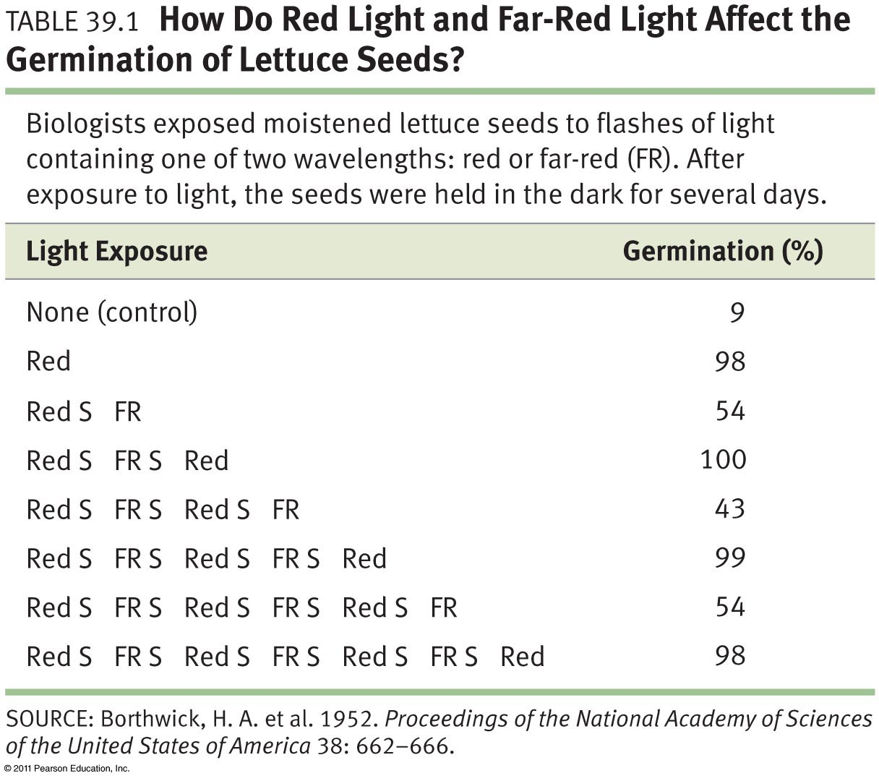
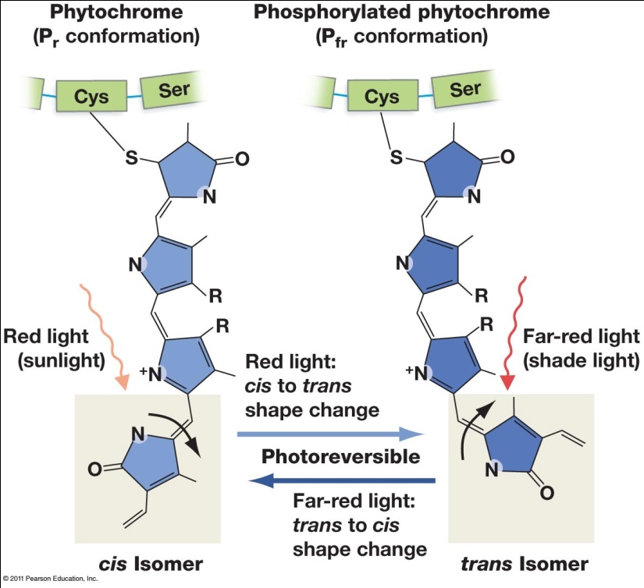
Red/Far-Red phytochromes are photoreversible
Other photoreceptors are involved in germination and stem elongation
Phytochromes have two conformations

Slide 8
The role of hormones
Small, simple molecules present at very small concentrations
Can be transported around the plant to affect target cells
Only elicit response if receptor is present

Slide 9
Hormones in the plant
Move cell-to-cell, via xylem and phloem, or diffusion
Plant growth regulators (aka hormones):
Auxin
Cytokinins
Gibberellins (GAs)
Abscisic acid (ABA)
Brassinosteroids
Ethylene

Slide 10
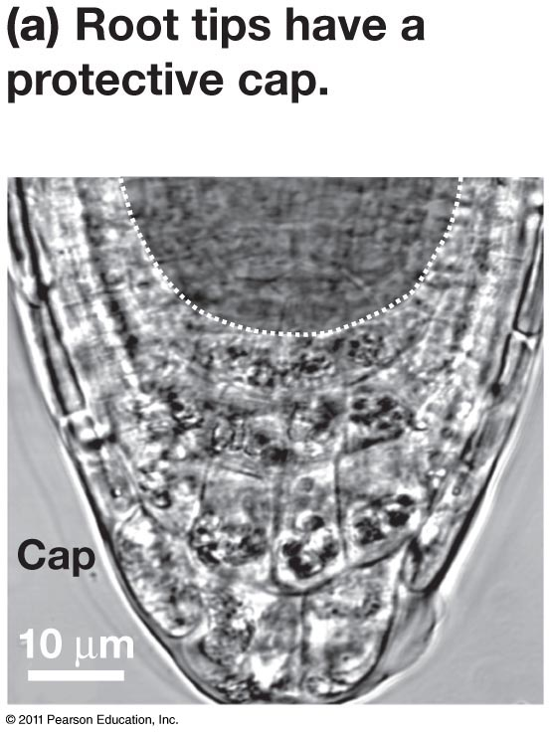
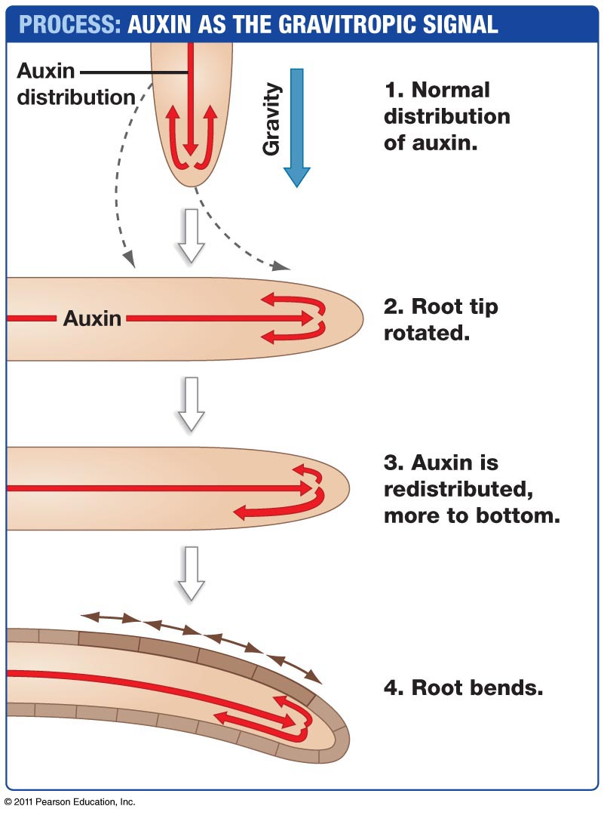
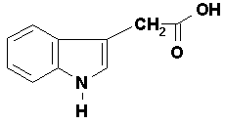
Auxin
Auxin = indoleacetic acid
Auxins are found in embryos, apical meristems, young leaves.
Involved in root growth, cell differentiation, phototropism, gravitropism, xylem differentiation.
IAA structure from: http://www.plant-hormones.info/auxins.htm
Notes:
The term auxin is used for any chemical substance that promotes cell elongation in different target tissues

Slide 11
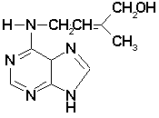
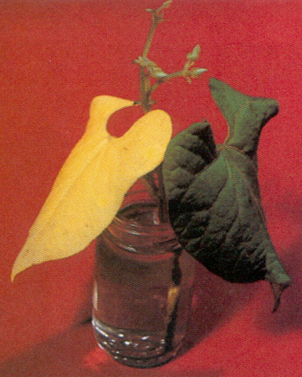
Cytokinins
Zeatin first isolated in 1961 (from maize).
>200 natural and synthetic cytokinins.
Produced in roots, young fruits, and seeds.
Move upward via the xylem.
Interact with auxins to control
Cell division and differentiation
Apical dominance
Delays senescence
IAA structure from: http://www.plant-hormones.info/cytokinins.htm
http://www.cropsci.illinois.edu/classes/cpsc112/images/PGR/Cytoeffect.jpg

Slide 12
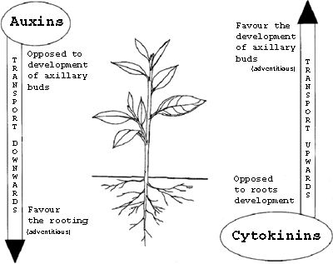
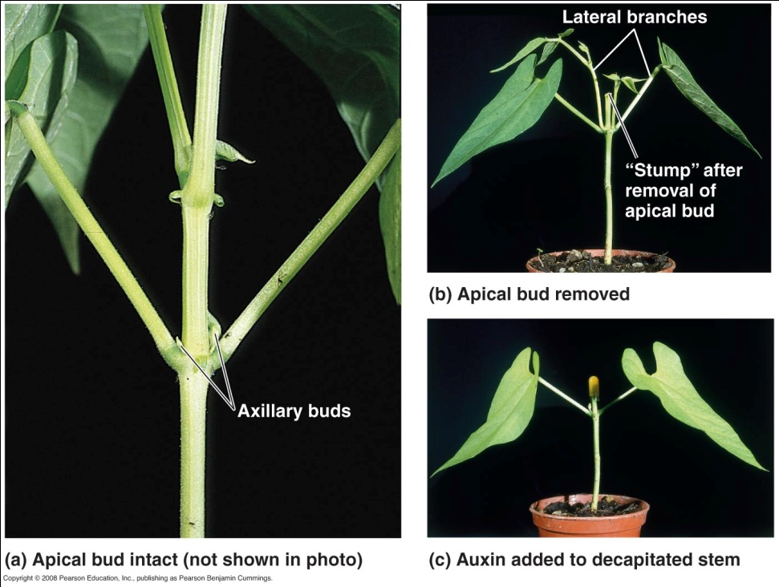
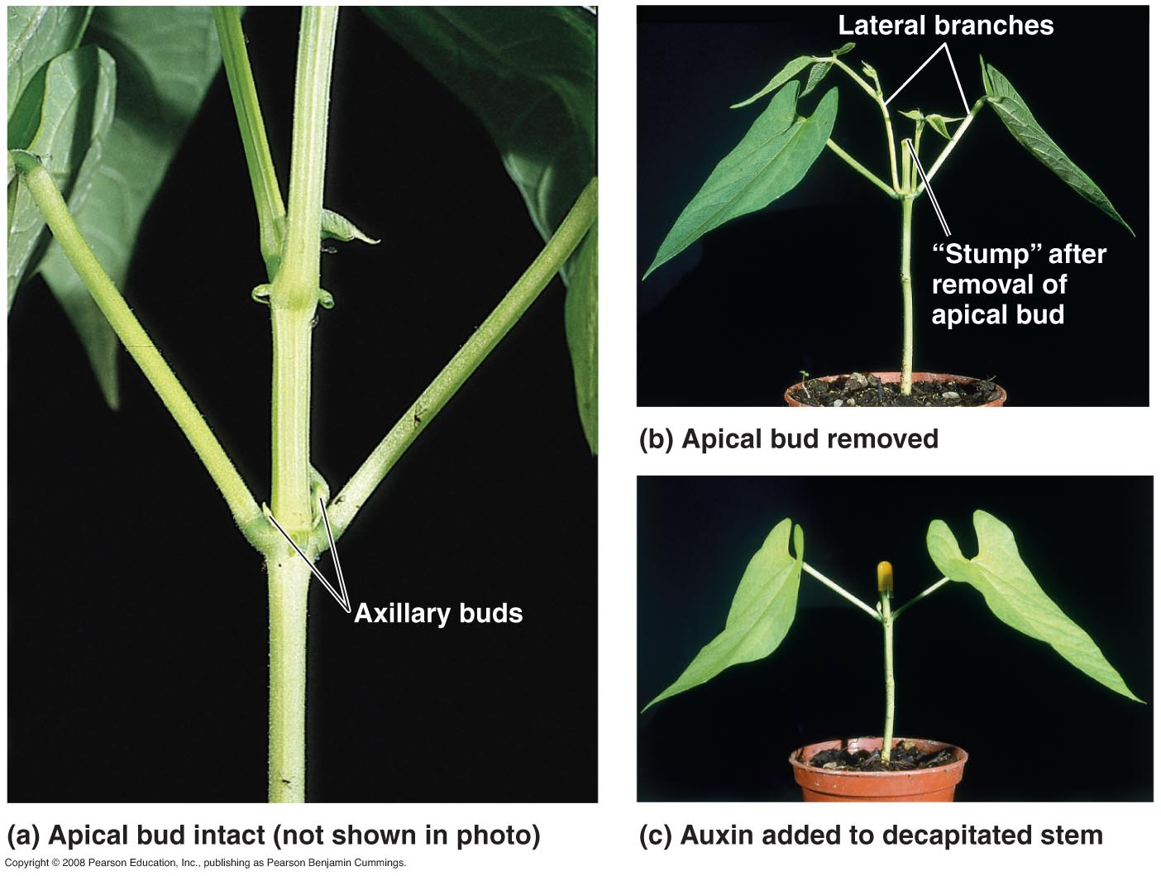
Auxin - Cytokinin Interactions
Apical bud removal releases inhibition of lateral buds.
Lateral buds require cytokinins to actually grow.
Campbell & Reece, Fig. 39.09
Right: http://www2.ulg.ac.be/cedevit/english/hormones_e.htm

Slide 13
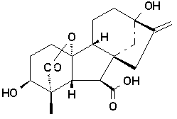
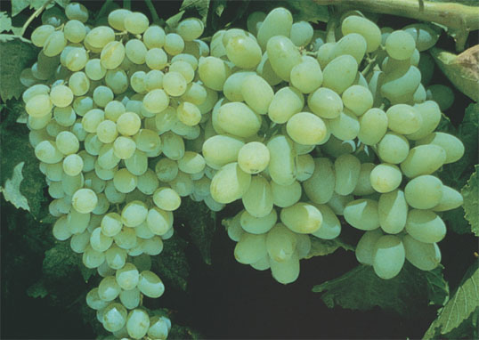
Gibberellins
Effects first observed in “bakanae” rice infected with a fungus (Gibberella fujikuroi)
GA isolated in 1938
Produced in apical buds, young leaves, and embryos
Effects include:
stem elongation
fruit growth
seed germination
Plus Gibberellin
No Gibberellin
GA structure from: http://www.plant-hormones.info/gibberellins.htm
Pictures: http://www.jppn.ne.jp/kagawa/syasin/inebyougaityuu.html

Slide 14
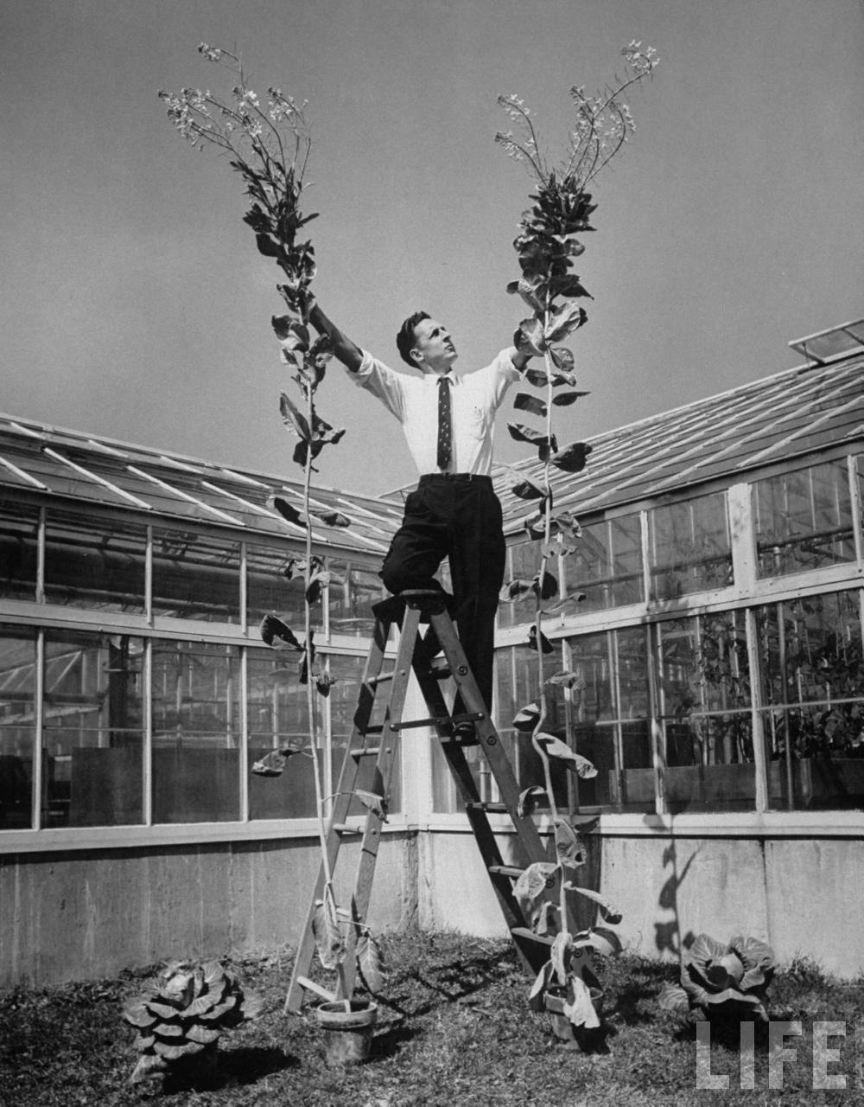
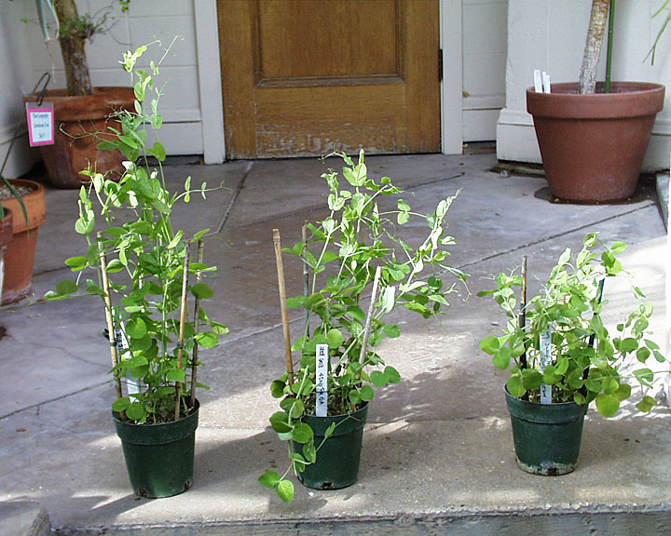
Gibberellins and Plant Growth
GA can promote gigantism in
normal plants.
GA applied to dwarf plants yield normal growth.
+GA
+0.1GA
+0.01GA
Beanstalk cabbages, Michigan State
Left: dwarf peas titrated with GA, http://digicoll.library.wisc.edu/
Right: Life Magazine, Al Fenn, photographer

Slide 15
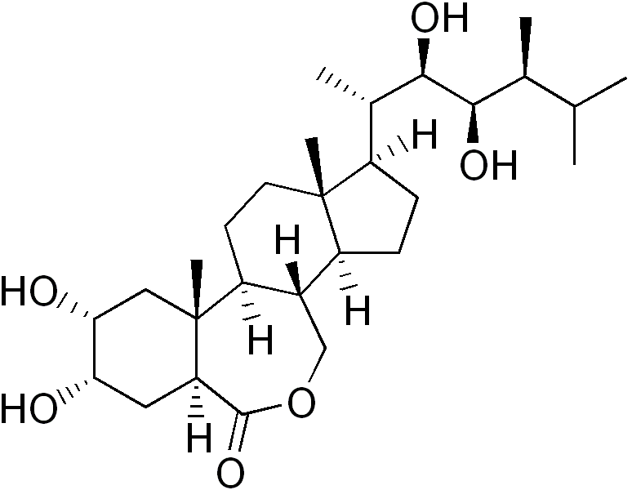
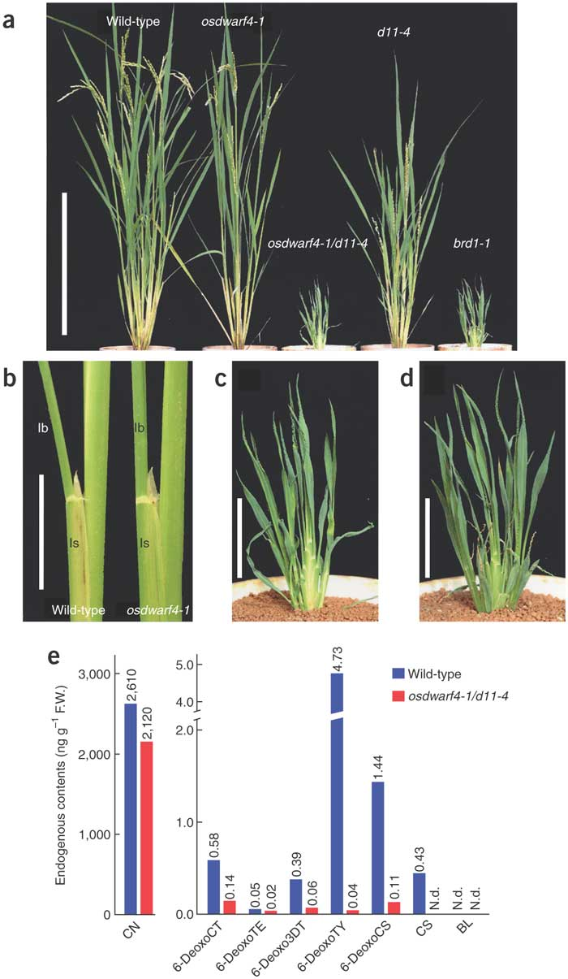
Brassinosteroids
Steroidal plant hormones first identified in 1979.
Similar effects to those of auxins
Promote growth
Increase crop yield and quality
Small decreases in brassinosteroids change rice morphology and improve yields
Brassinosteroid content
Brassinolide structure: http://en.wikipedia.org/wiki/File:Brassinolide.png
Lower: Sakamoto et al. 2005. Nature Biotechnology 24: 105-109.

Slide 16
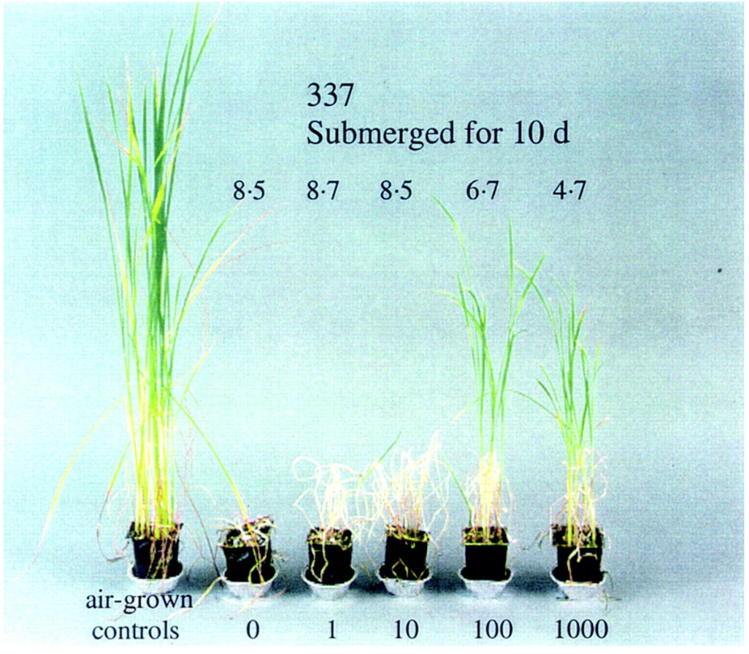
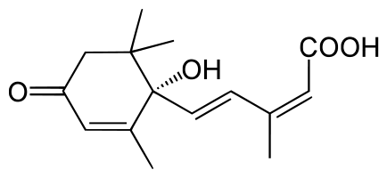
Abscissic Acid (ABA)
Discovered in 1963
First thought to induce leaf abscission.
Slows or halts growth.
Induces seed dormancy
Inhibits cell division in
vascular cambium
Increases drought tolerance by closing stomata.
Campbell & Reece, Fig. 39.12
ABA structure: http://en.wikipedia.org/wiki/File:Abscisinsäure.svg

Slide 17
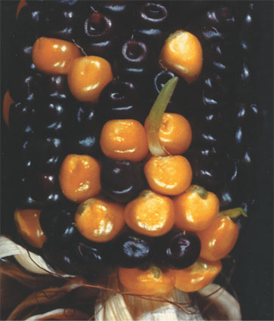
ABA – Promotes Seed Dormancy
Coleoptile
Seed dormancy has great survival value because it ensures that the seed will germinate only when there are optimal conditions
Precocious germination is observed in maize mutants that lack a functional transcription factor required for ABA to induce expression of certain genes
Mutant without ABA activity. Note germination of seeds on the cob.

Slide 18
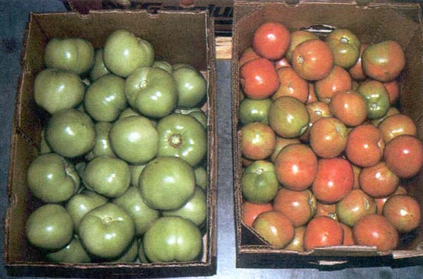
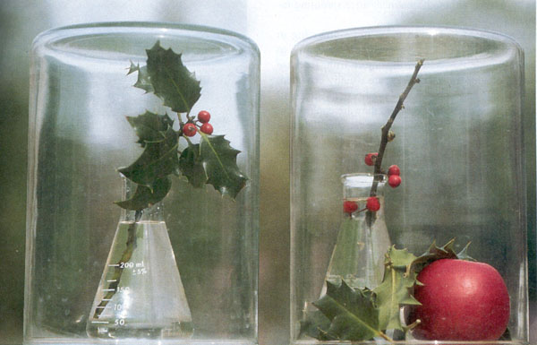
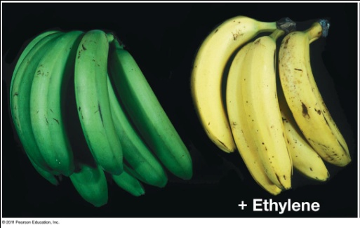
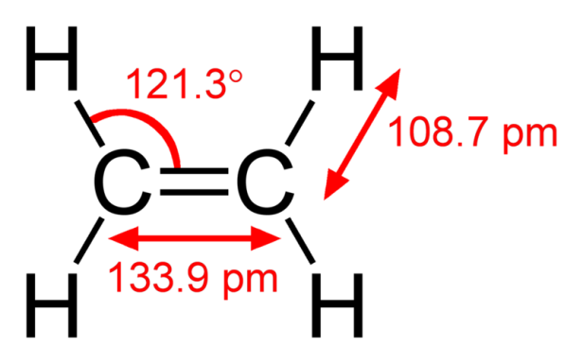
Ethylene
Chinese may have been first to note effect of ethylene (incense ripens fruit)
Plants produce C₂H₂ in response to stresses:
Drought or Flooding
Injury or Infection
Effects include fruit ripening, leaf/fruit abscission, triple response.
Pictures: http://www.cropsci.illinois.edu/classes/cpsc112/Topicpages/PGR.cfm
C₂H₄ structure: http://en.wikipedia.org/wiki/File:Ethylene-CRC-MW-dimensions-2D.png

Slide 19
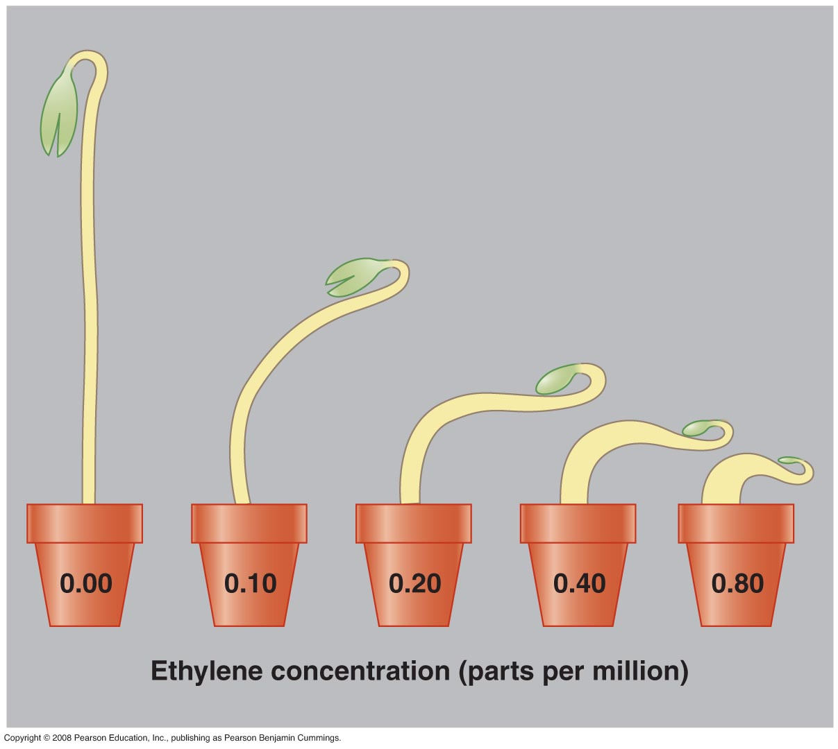
Ethylene Triple Response
Reduced stem elongation
Thickened stem
Horizontal growth
Campbell & Reece, Fig. 39.13

Slide 20
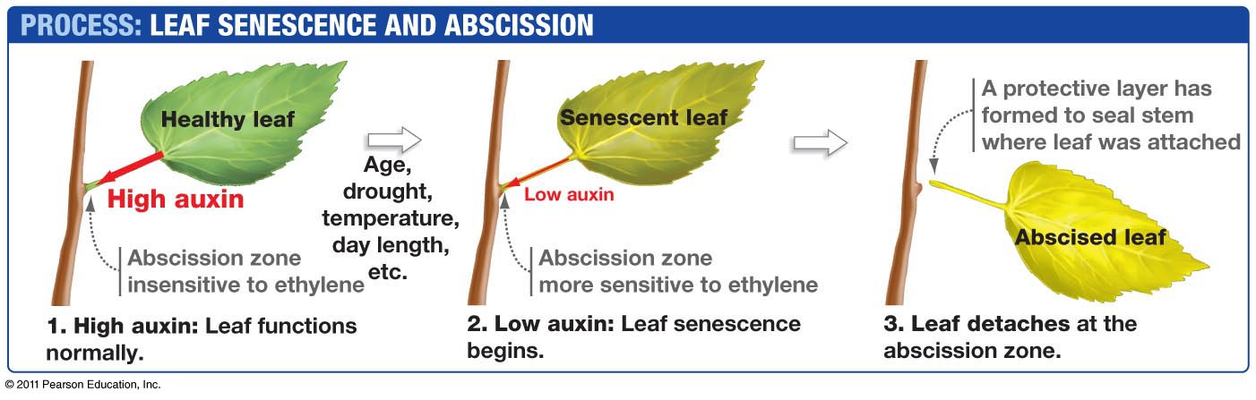
Leaves drop in the fall with the help of auxin and ethylene

Slide 21
Plant defenses
Physical Defenses
Chemical Defenses
Thorns
Waxy epidermis
Sap
Constitutive vs. Induced
Poison Ivy (urushiol)
Opium, caffeine, cocaine, nicotine, THC
Release of secondary metabolites
Distasteful
“Talking trees”
http://www.youtube.com/watch?v=rLtUk-W5Gpk&feature=results_video&playnext=1&list=PL6A814F144F90FAC9

Slide 22
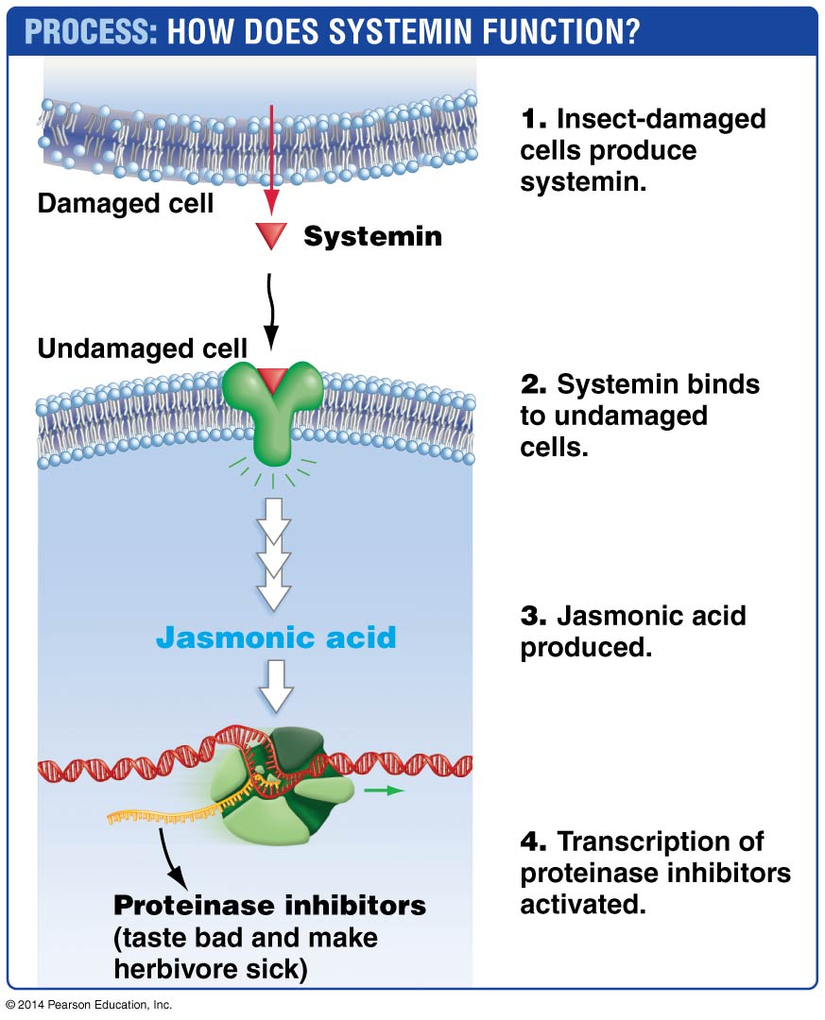
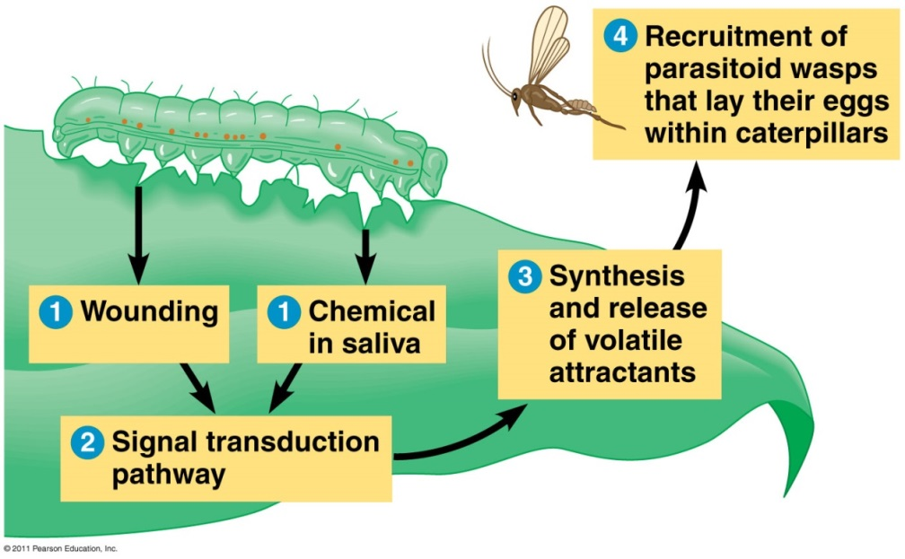
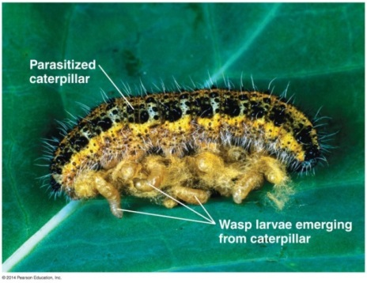
Herbivory: systemin, jasmonic acid, and proteinase inhibitors, and/or volatile compounds (“talking trees”)
Campbell 8e chapter 39 figure 28
“Talking trees”: release volatile compounds that are released due to herbivory and
Induce responses in neighboring plants
Recruit parasitoids that lay eggs inside the herbivorous insects, killing them
Systemin is named for the fact that it is locally induced but has effects throughout the entire plant due to movement through phloem. Systemin is induced by herbivory by insects and activates jasmonic acid in other, undamaged cells. Jasmonic acid results in transcription of proteinase inhibitors which taste bad and make the herbivore sick, thus deterring further herbivory.

Slide 23
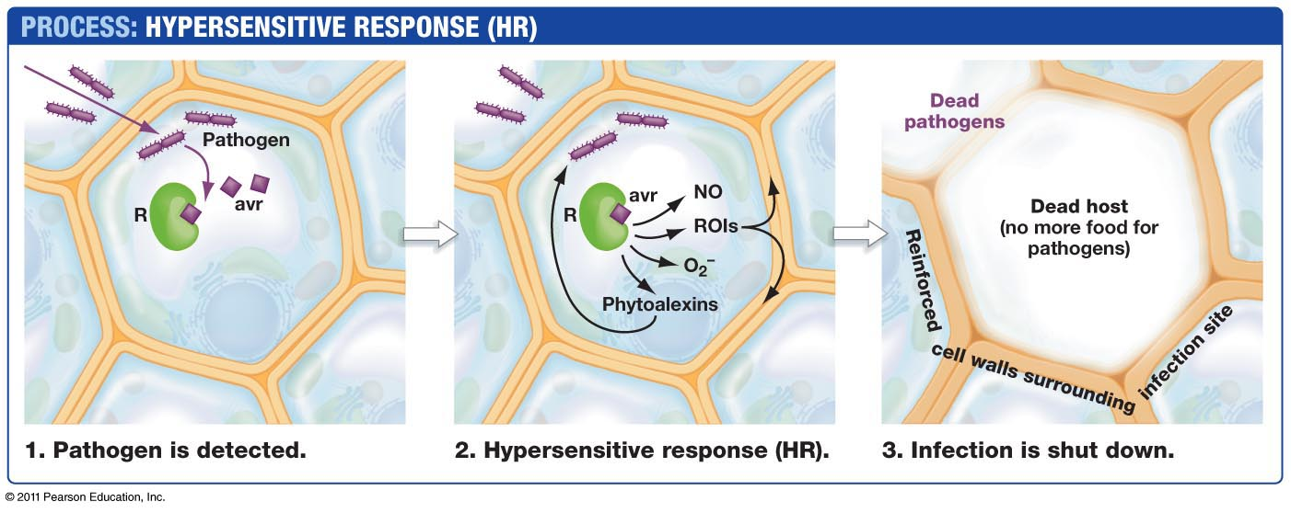
Pathogens: first response - Hypersensitive response (HR)
Pathogen-specific response (recognizes specific microbes); results in local programmed cell death of infected cells to prevent pathogen spreading to healthy tissues:
Recognition of specific pathogen molecules (requires specialized, pathogen-specific receptors)
Induction of stress response genes and phytoalexins (toxins that help kill pathogens)
Walling off of infected cells to prevent pathogen escape
Local cell death of infected tissues

Slide 24
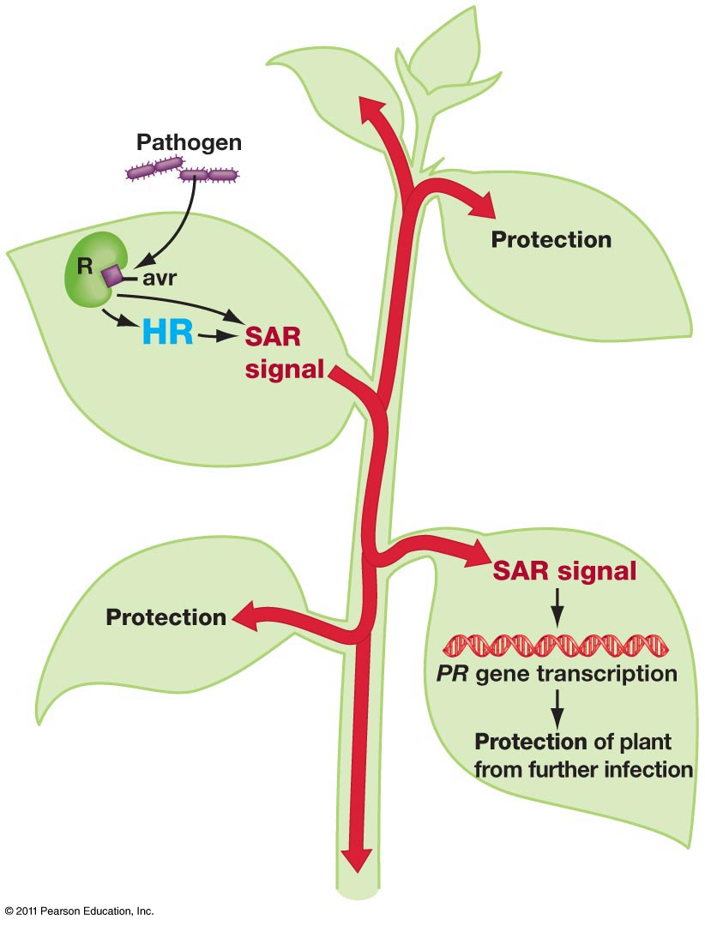
Pathogens: Second response- systemic acquired response (SAR)
A general anti-pathogen response activated throughout the plant in response to local activation of the hypersensitive response (SAR doesn’t activate without HR)
Hormone methyl salicylate (MeSA) released from infected site
Activates transcription of general pathogenesis-related (PR) genes (not pathogen-specific) as defense against pathogen spread/new infection
Slower response than HR; systemic response instead of local

Slide 25
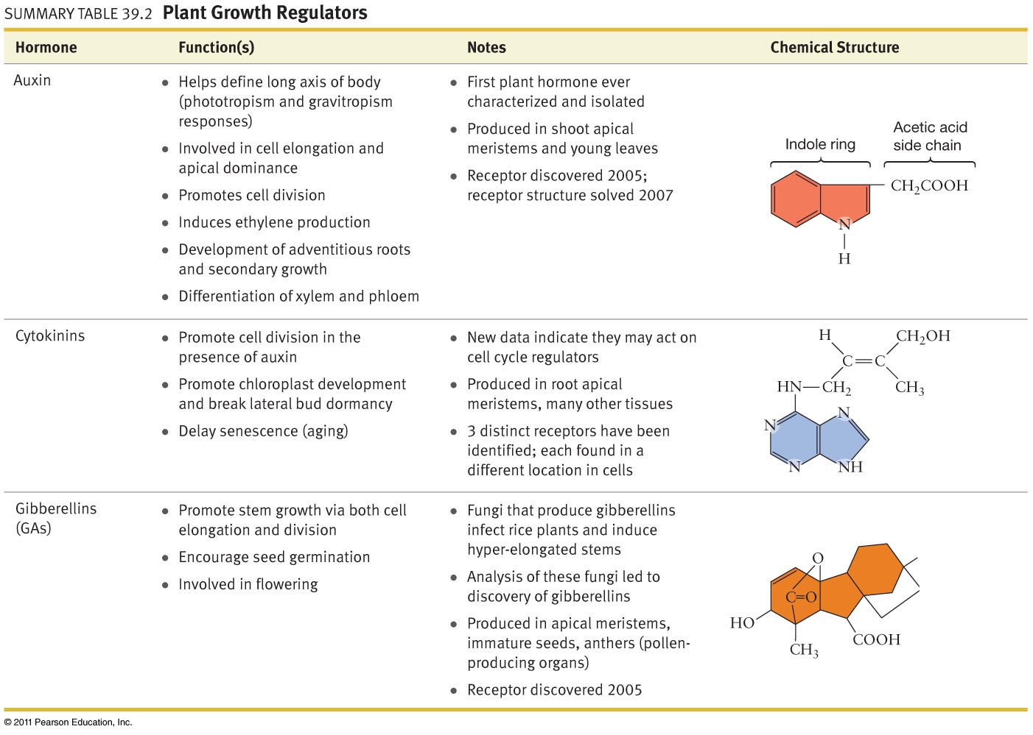

Slide 26
